Slide 1
Answer here
https://www.youtube.com/watch?v=ysa5OBhXz-Q
Answer here
Answer here
Is your work saved?
Go Back to Lab Room

Slide 2
Type/draw here.
Type/draw here.
Type/draw here.
Continue to Part 2

Slide 3
Type/draw here.
Type/draw here.
Continue to Questions

Slide 4
Answer here
Answer here
Answer here
Is your work saved?
Go Back to Lab Room

Slide 5
Answer here
Answer here
Go to Part 2

Slide 6
Answer here
Answer here
Answer here
Go to Part 3

Slide 7

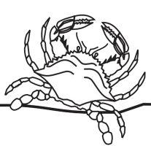


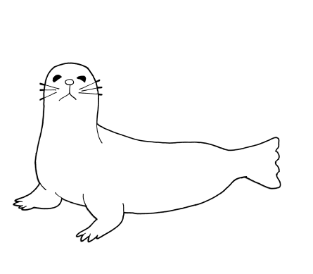
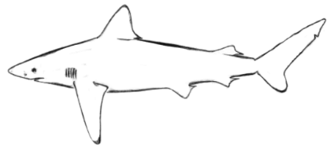
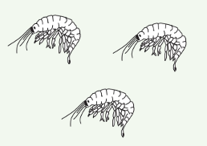


Is your work saved?
Go Back to Lab Room

Slide 8
Answer here
Answer here
Answer here
Go to Part 2

Slide 9
Answer here
Answer here
Answer here
Answer here
Answer here
Is your work saved?
Go Back to Lab Room

